Slide 1
Chapter 5: Combinational Logic Analysis

Slide 2
Chapter Objectives
After studying this chapter, students should be able to:
Analyze basic combinational logic circuits such as AND-OR, AND-OR-Invert, Exclusive-OR, and Exclusive-NOR.
Use AND-OR and AND-OR-Invert circuits to implement sum-of-products (SOP) and product-of-sums (POS) expressions.
Write equivalent logic expressions for any combinational logic circuit.
Develop a truth table from the output expression of a combinational logic circuit.
Use Karnaugh maps to simplify logic expressions and design combinational logic circuits.
Design and implement a combinational logic circuit from a truth table or logic expression.
Use NAND and NOR gates to implement any combinational logic function.

Slide 3
Chapter Outline
5.1 Basic Combinational Logic Circuits 5.2 Implementing Combinational Logic 5.3 The Universal Property of NAND and NOR Gates 5.4 Combinational Logic Using NAND and NOR Gates 5.5 Pulse Waveform Operation 5.6 Implementing Combinational Logic with VHDL Multiple-choice test and Problems

Slide 4
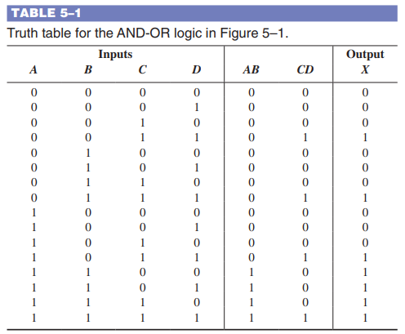
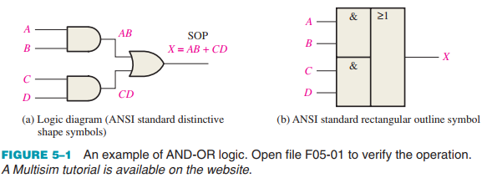
5.1. Basic Combinational Logic Circuits
AND-OR Logic AND-OR logic produces an SOP expression.

Slide 5
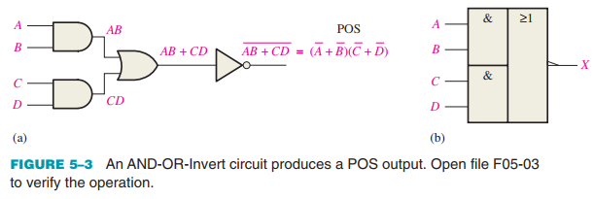
5.1. Basic Combinational Logic Circuits
AND-OR-Invert Logic When the output of an AND-OR circuit is complemented (inverted), it results in an AND-OR-Invert circuit.
For a 4-input AND-OR-Invert logic circuit, the output X is LOW (0) if both input A and input B are HIGH (1) or both input C and input D are HIGH (1).

Slide 6

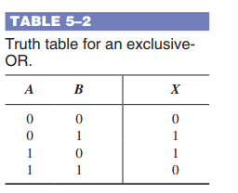
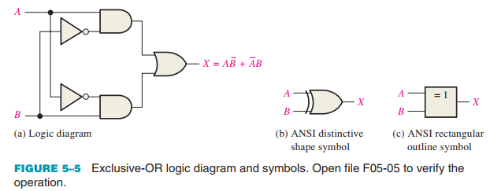

5.1. Basic Combinational Logic Circuits
Exclusive-OR Logic The XOR gate is actually a combination of other gates.

Slide 7
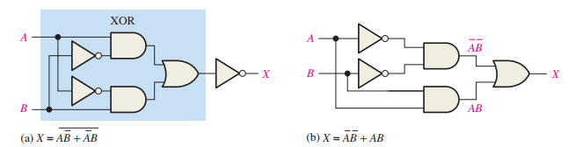
5.1. Basic Combinational Logic Circuits
Exclusive-NOR Logic As you know, the complement of the exclusive-OR function is the exclusive-NOR, which is derived as follows:

Slide 8


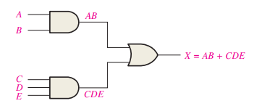
5.2. Implementing Combinational Logic
From a Boolean Expression to a Logic Circuit For every Boolean expression there is a logic circuit, and for every logic circuit there is a Boolean expression.

Slide 9

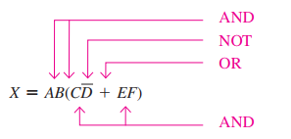
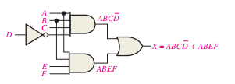
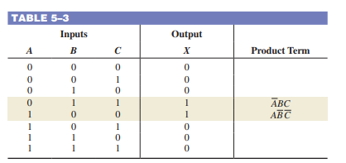
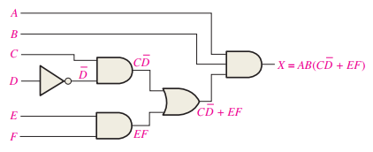
5.2. Implementing Combinational Logic
From a Boolean Expression to a Logic Circuit For every Boolean expression there is a logic circuit, and for every logic circuit there is a Boolean expression.

Slide 10

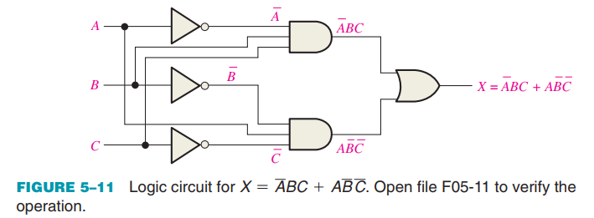
5.2. Implementing Combinational Logic
From a Truth Table to a Logic Circuit The Boolean SOP expression obtained from the truth table by ORing the product terms for which X = 1 is:

Slide 11



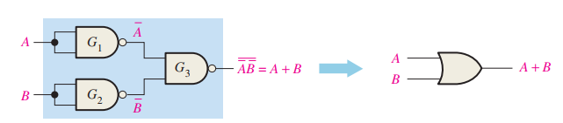
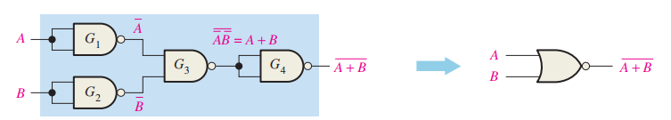
5.3. The Universal Property of NAND and NOR Gates
The NAND Gate as a Universal Logic Element Combinations of NAND gates can be used to produce any logic function:

Slide 12



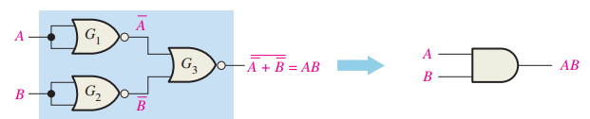
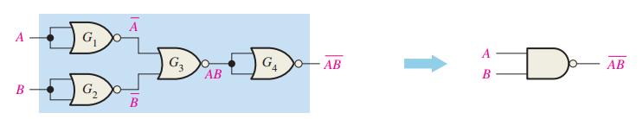
5.3. The Universal Property of NAND and NOR Gates
The NOR Gate as a Universal Logic Element Combinations of NOR gates can be used to produce any logic function.

Slide 13

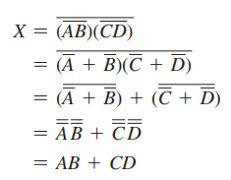
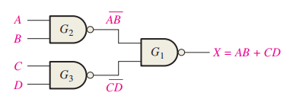
5.4. Combinational Logic Using NAND and NOR Gates
NAND Logic: A NAND gate can function as either a NAND or a negative-OR because, by DeMorgan’s theorem.

Slide 14
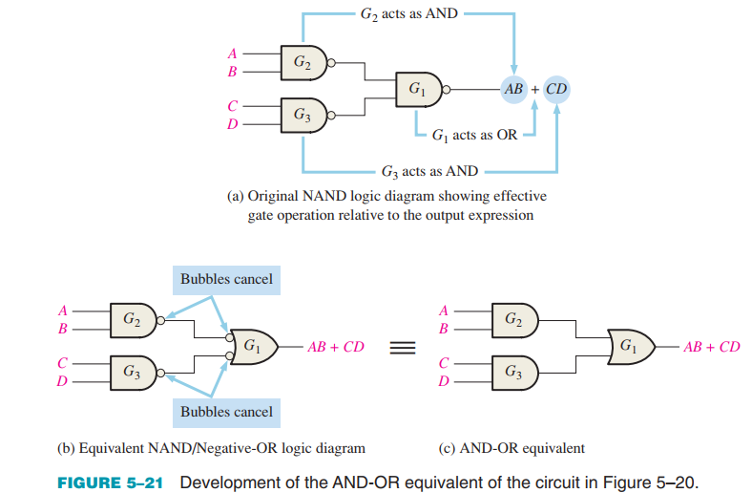
5.4. Combinational Logic Using NAND and NOR Gates
NAND Logic: A NAND gate can function as either a NAND or a negative-OR because, by DeMorgan’s theorem.

Slide 15
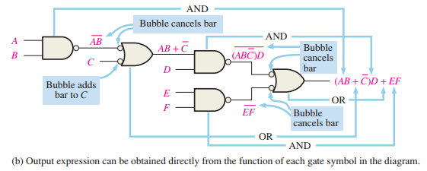
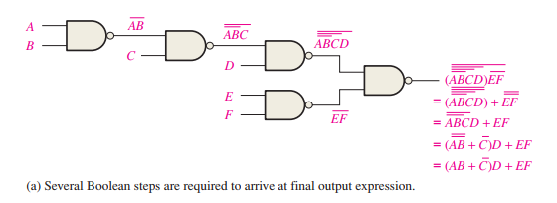
5.4. Combinational Logic Using NAND and NOR Gates
NAND Logic Diagrams Using Dual Symbols
All logic diagrams using NAND gates should be drawn with each gate represented by either a NAND symbol or the equivalent negative-OR symbol to reflect the operation of the gate within the logic circuit. The NAND symbol and the negative-OR symbol are called dual symbols

Slide 16

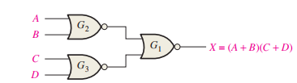

5.4. Combinational Logic Using NAND and NOR Gates
NOR Logic: A NOR gate can function as either a NOR or a negative-AND, as shown by DeMorgan’s theorem

Slide 17
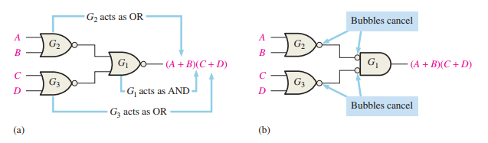
5.4. Combinational Logic Using NAND and NOR Gates
NOR Logic: A NOR gate can function as either a NOR or a negative-AND, as shown by DeMorgan’s theorem

Slide 18
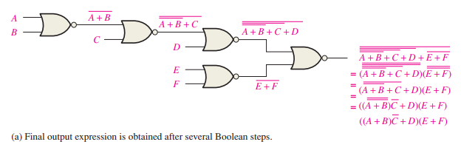
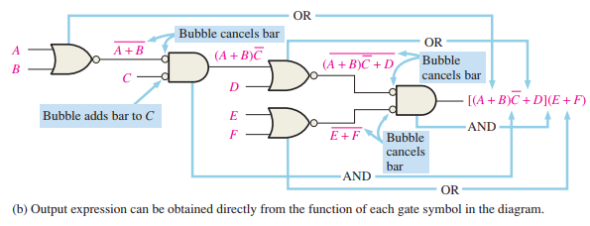
5.4. Combinational Logic Using NAND and NOR Gates
NOR Logic Diagram Using Dual Symbols As with NAND logic, the purpose for using the dual symbols is to make the logic diagram easier to read and analyze, as illustrated in the NOR logic circuit in Figure 5–28.

Slide 19
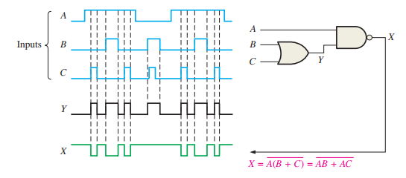
5.5. Pulse Waveform Operation
The output of a logic circuit at any given time depends on the inputs at that particular time, so the relationship of the time-varying inputs is of primary importance.

Slide 20
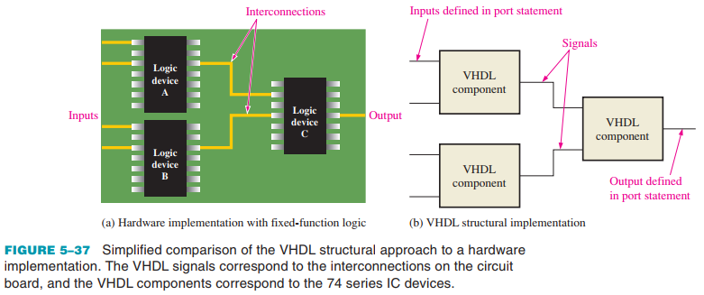
5.6. Implementing Combinational Logic with VHDL
Structural Approach to VHDL Programming The VHDL component is a way to predefine a logic function for repeated use in a program or in other programs. The component can be used to describe anything from a simple logic gate to a complex logic function. The VHDL signal can be thought of as a way to specify a “wire” connection between components.

Slide 21
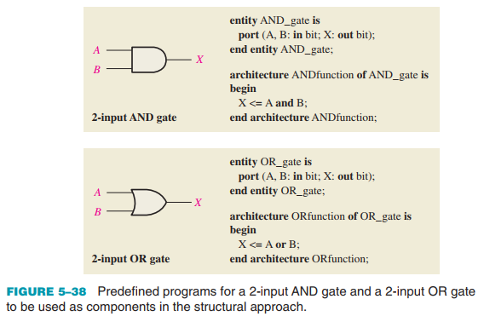

5.6. Implementing Combinational Logic with VHDL
Structural Approach to VHDL Programming The VHDL component is a way to predefine a logic function for repeated use in a program or in other programs.

Slide 22
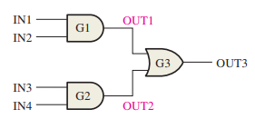

5.6. Implementing Combinational Logic with VHDL
Using Components in a Program The port statement in the component declaration must correspond to the port statement in the entity declaration of the AND gate.

Slide 23

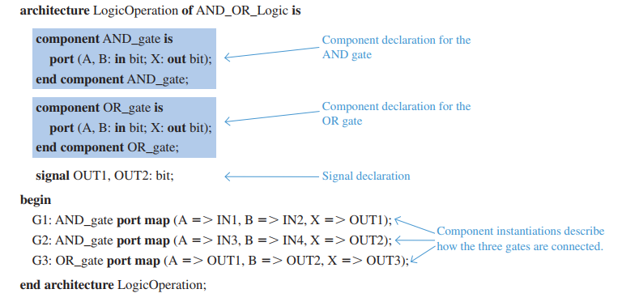
5.6. Implementing Combinational Logic with VHDL
The Program
The architecture declaration contains the component declarations for the AND gate and the OR gate, the signal definitions, and the component instantiations.

Slide 24
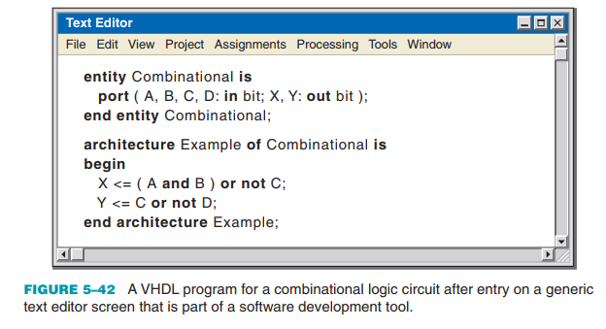
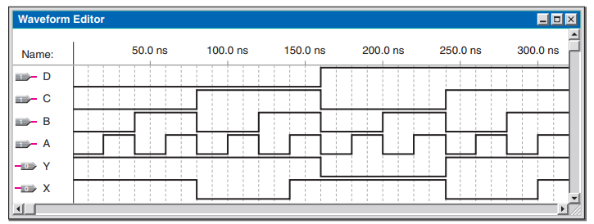
5.6. Implementing Combinational Logic with VHDL
Applying Software Development Tools Once the logic has been described using an HDL and entered via a software tool called a code or text editor, it can be tested using a simulation to verify that it performs properly before actually programming the target device.

Slide 25
SUMMARY
Chapter 5: Combinational Logic Analysis
AND-OR logic circuits produce output expressions in sum-of-products (SOP) form.
AND-OR-Invert logic circuits produce complemented SOP form, which is actually a product-of-sums (POS) form.
The exclusive-OR operation can be expressed in multiple equivalent ways.
To analyze a logic circuit, start with the circuit and then develop the Boolean expression or truth table.
NAND and NOR logic diagrams should use correct symbols to indicate bubbled and non-bubbled inputs and outputs.
In VHDL, a component is a predefined logic function, and a signal acts as an internal connection between components in a structural description.

Slide 26
MULTIPLE-CHOICE TEST AND PROBLEMS
Complete the true/false questions, multiple-choice questions, and end-of-chapter exercises in the primary textbook.

